Slide 1
What Is Threat Modeling?
Threat modeling is the process of identifying potential threats and vulnerabilities in a system and determining the likelihood and impact of each threat. The goal of threat modeling is to proactively identify potential security risks and address them before they can be exploited by attackers.
That is a systematically listing all the potential ways one can attack an application. So Threat Modeling is a process for looking at attacks actively. The output of this process is a list of threats or probable threat scenarios also our approach should be Holistic to consider all threats not a specific part of an application. On the other hand Threat modeling is a Collaborative and Repeatable process.
The Benefits of Threat Modeling
Threat modeling provides a number of benefits to software development teams, including:
Identifying potential security risks early in the SDLC, reducing the cost and effort required to address them later.
Prioritizing security efforts based on the likelihood and impact of potential threats
Improving communication between development and security teams by providing a shared understanding of security risks and mitigation strategies
Common Threat Modeling Methodologies
There are several methodologies used in threat modeling, including:
PASTA
Microsoft Threat Modeling
OCTAVE
TRIKE
VAST

Slide 2
Process Outputs:
Diagrams
Security requirements
Non-requirements
List of threats / vulnerabailties
Terms:
Weakness:
A software defect or bug (Ex: missing user email validation)
Vulnerability:
A weakness that can be exploited. (Ex: The user email field can be abused to insert SQL statement)
Attack:
Target: the value of an attack
Attack Vector: the path that attacker can take to exploit a vulnerability
Threat Actor: threat source.
Attack Surface:
Anything that can be obtained, used, or attacked by a threat actor
Risk:
Risk = Impact * Likelihood
Why Threat Modeling?
As main reasons for using threat modeling we can say:
Pro-active approach to finding threats
Increasing efficiency by reducing cost

Slide 3
A better prioritization based on bugs and mitigation plan
A better understanding of the system
Who should the threat model?
Architect, who knows how the application has been designed and how data flows across.
Developer, who knows the elaborate details on how the application was built, the detailed interactions between components.
Tester, who knows the requirements, and what the application is supposed to do.
Security expert, who knows about specific attack factors and vulnerabilities. However, the best answer to this question is, It depends on the organization.
When to perform Threat modeling?
Since, the earlier you find vulnerabilities in software, the easier and cheaper it is to fix them, Threat Modeling should be as early as possible in the software design process. If you are working in an agile environment, ideally the threat modeling should be done during each sprint.
Select the Right approach & Methodology
Here we have to term 1st is Approach that describes how one could start with the process with threat modeling and 2nd is Methodology which describes the process itself. So each of the methodologies is based on one of the 3 available approaches.
Approaches
Asset-centric Approach:
According to the name, it turns around assets. So the producing steps are as follows:
Create a list of assets
Draw assets, components and data flows
For each element, check for threats

Slide 4
By repeating these steps for all assets, a list of threats will be produced.
Attacker-centric Approach:
Staring threat modeling from an attacker perspective. So the producing steps are as follows:
Create a list of threat actors
Motive
Means
Opportunity
Create a list of threats
Application-centric Approach:
This one starts with visualizing the application instead of thinking about the risks or attacks first. So the producing steps are as follows:
Draw a diagram of the application
List threats for each element
STRIDE:
Identifying threats based on the following categories: Spoofing, Tampering, Repudiation, Information Disclosure, Denial of Service, and Elevation of Privilege
DREAD:
Assessing threats based on the following criteria: Damage potential, Reproducibility, Exploitability, Affected users, and Discoverability
PASTA:
Identifying potential attack scenarios and evaluating the risks associated with each scenario
OWASP TOP 10

Slide 5
How to Build a Threat Model Using the STRIDE Methodology
STRIDE is a widely used methodology for threat modeling that focuses on identifying threats based on the following categories:
Spoofing, Tampering, Repudiation, Information Disclosure, Denial of Service, and Elevation of Privilege. The STRIDE methodology provides a structured approach to threat modeling that can be easily integrated into the SDLC. The following are the elements of STRIDE and the assets they apply to:
Spoofing: Spoofing refers to the ability of an attacker to impersonate a user or system component. This can be a serious threat to authentication systems and other security controls. Assets that are vulnerable to spoofing include usernames, passwords, and digital certificates.
Tampering: Tampering refers to the ability of an attacker to modify data or software without detection. This can be a serious threat to data integrity and system availability. Assets that are vulnerable to tampering include software binaries, configuration files, and data in transit.
Repudiation: Repudiation refers to the ability of an attacker to deny that a particular action was taken. This can be a serious threat to audit trails and other compliance controls. Assets that are vulnerable to repudiation include logs, audit trails, and digital signatures.
Information Disclosure: Information disclosure refers to the ability of an attacker to gain unauthorized access to sensitive data. This can be a serious threat to confidentiality and privacy. Assets that are vulnerable to information disclosure include customer data, financial data, and intellectual property.
Denial of Service: Denial of Service refers to the ability of an attacker to disrupt the normal operation of a system or network. This can be a serious threat to availability and can result in lost productivity and revenue. Assets that are vulnerable to denial of service include web servers, routers, and other network infrastructure.
Elevation of Privilege: Elevation of privilege refers to the ability of an attacker to gain unauthorized access to system resources or functions. This can be a serious threat to data integrity and confidentiality. Assets that are vulnerable to elevation of privilege include administrative functions, privileged user accounts, and system-level processes.

Slide 6
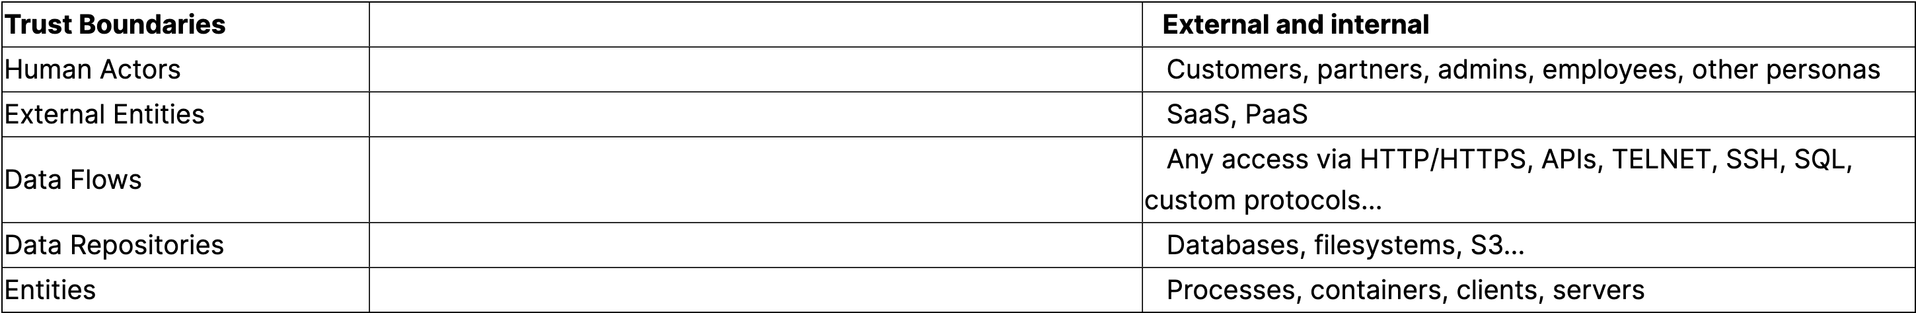
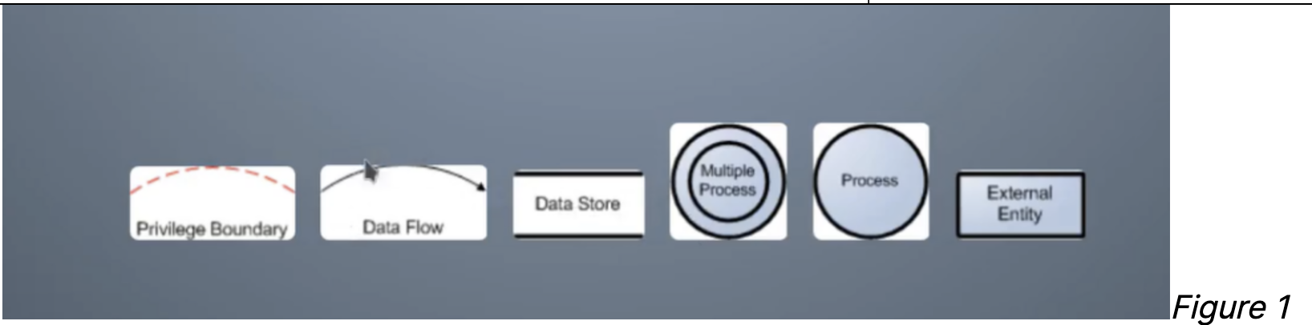
By applying the STRIDE methodology to a threat model, development teams can identify potential threats and develop mitigation strategies that are tailored to the specific assets and vulnerabilities of the system. What follows are the detailed steps on how to apply STRIDE to a design. The next section will take you through some design patterns and how STRIDE was used to discover design weaknesses.
Design Review: Identifying Assets, Trust Boundaries, and Threats
Decompose a design based on the following concepts. Figure 1 shows some of these components and boundaries:

Slide 7
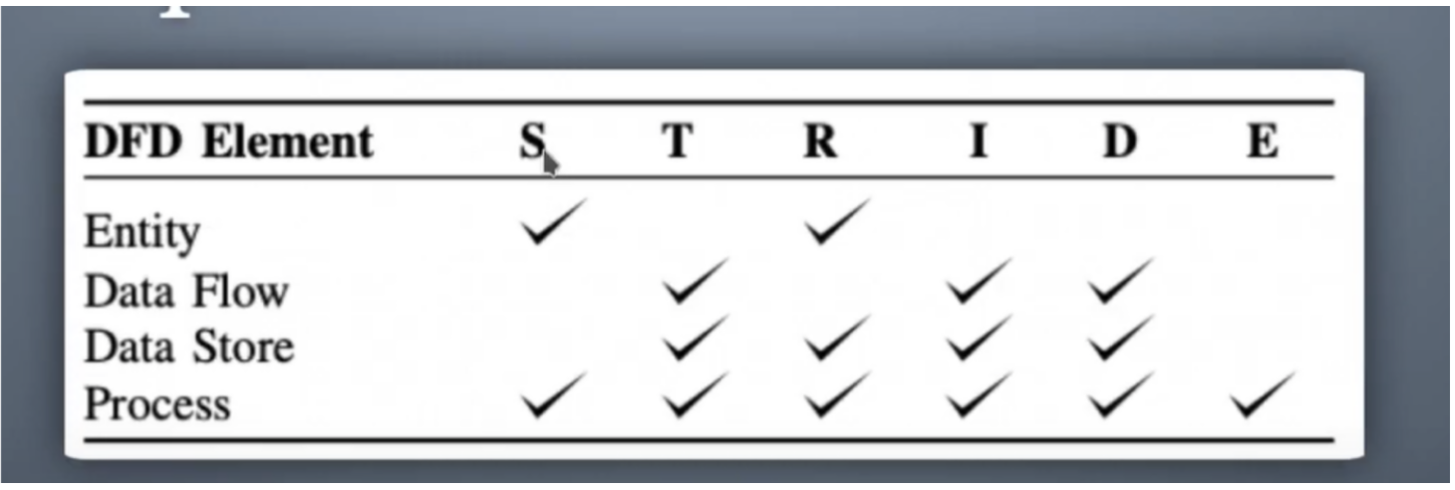
Here is how STRIDE is applied to boundaries and entities, a.k.a. “What applies where”:
Here are the common assets and corresponding STRIDE elements that apply to them:

Slide 8
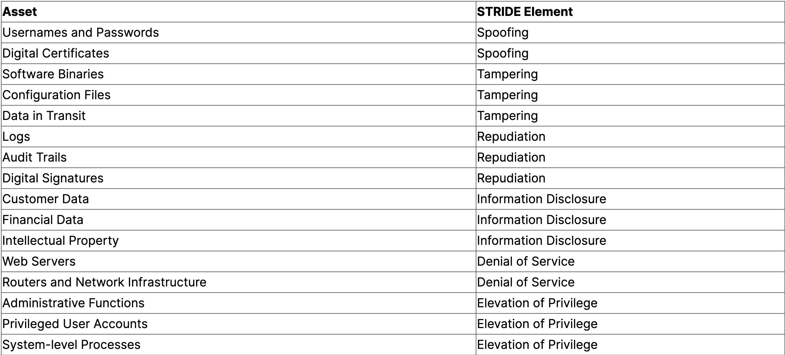

Slide 9
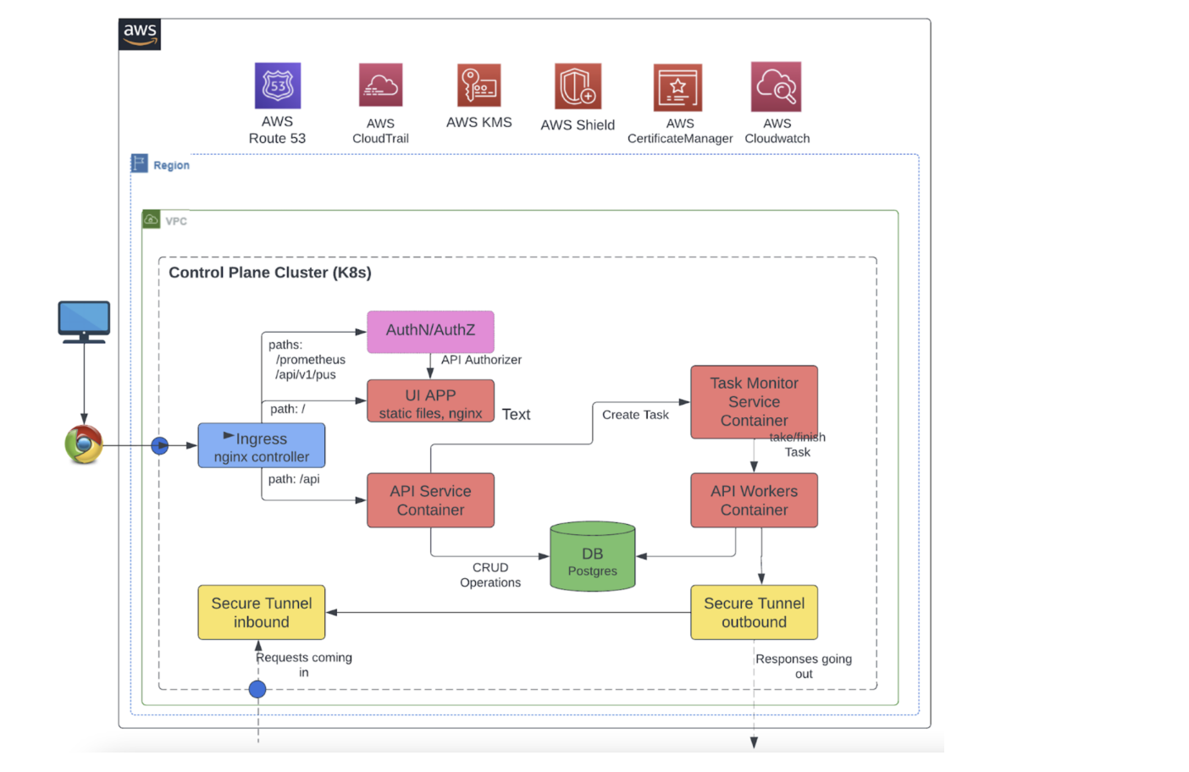
By identifying the assets and the corresponding STRIDE element, development teams can prioritize the most critical assets and apply mitigation strategies that are tailored to the specific threats facing those assets. To apply some of the principles of threat modeling and STRIDE, we’ll consider a common cloud-based service architecture that we’ll take through a thread modeling exercise:

Slide 10
Special Attention: Authentication and Authorization Bypass Attacks
Most services like the one depicted in Figure 3 above will have a web interface or API. Note that these external interfaces could be subject to authentication and authorization bypass attacks.
What Are Authentication Bypass Attacks?
Authentication bypass attacks occur when an attacker is able to gain access to a web service or API without providing valid credentials. This can happen due to flaws in the authentication mechanism, such as insecure storage of passwords, lack of rate limiting on login attempts, or vulnerabilities that allow an attacker to impersonate a legitimate user. The implications of these attacks can be severe.
Unauthorized access to a web service or API can lead to data theft, data manipulation, execution of unauthorized actions, and potential compliance violations. In the case of APIs, which often act as gateways to a company’s most sensitive data and critical functions, an authentication bypass attack could have particularly serious consequences. It’s therefore crucial for both web services and APIs to implement robust authentication mechanisms and to regularly test and update these mechanisms to guard against potential attacks.
12 AuthN Bypass Attacks on Web Services
There are several ways in which authentication bypass can occur for a web service. Here are some common methods:
Credential Stuffing: This is when attackers use stolen or leaked usernames and passwords from one site on another, banking on the fact that many people reuse passwords across multiple sites.
Brute Force Attacks: Attackers use software to try many password combinations until they find one that works.
Phishing: Attackers trick users into providing their login credentials, usually by mimicking a legitimate website or service.
Session Hijacking: If an attacker can intercept a user’s session cookie (which keeps a user logged in), they can impersonate that user without needing their password.

Slide 11
Man-in-the-Middle (MitM) Attacks: Attackers intercept and potentially alter communication between two parties without their knowledge.
Exploiting Vulnerabilities: Software bugs or misconfigurations can sometimes allow attackers to bypass authentication. For example, a poorly implemented password reset feature might allow an attacker to reset someone else’s password.
SQL Injection: If user input isn’t properly sanitized, an attacker might be able to execute arbitrary SQL commands on a website’s database, potentially allowing them to bypass authentication.
Cross-Site Scripting (XSS): Similar to SQL injection, but with JavaScript. An attacker might be able to execute arbitrary JavaScript in a user’s browser, potentially allowing them to steal session cookies or perform actions on the user’s behalf.
Using Default or Weak Credentials: Many systems come with default usernames and passwords that are easily guessable if they aren’t changed. Similarly, weak or easily guessable passwords (like “password” or “123456”) can be exploited.
Social Engineering: This involves manipulating people into breaking normal security procedures, such as revealing their password or other sensitive information.
Keylogger Attacks: Malware installed on a user’s device can record keystrokes and send them to an attacker, revealing usernames and passwords.
Pass the Hash: In systems that use hashed credentials, an attacker who can steal the hash might be able to use it to authenticate without ever knowing the user’s actual password.
The following table summarizes these authentication bypass attacks, their STRIDE classification, and how to avoid introducing those vulnerabilities.

Slide 12
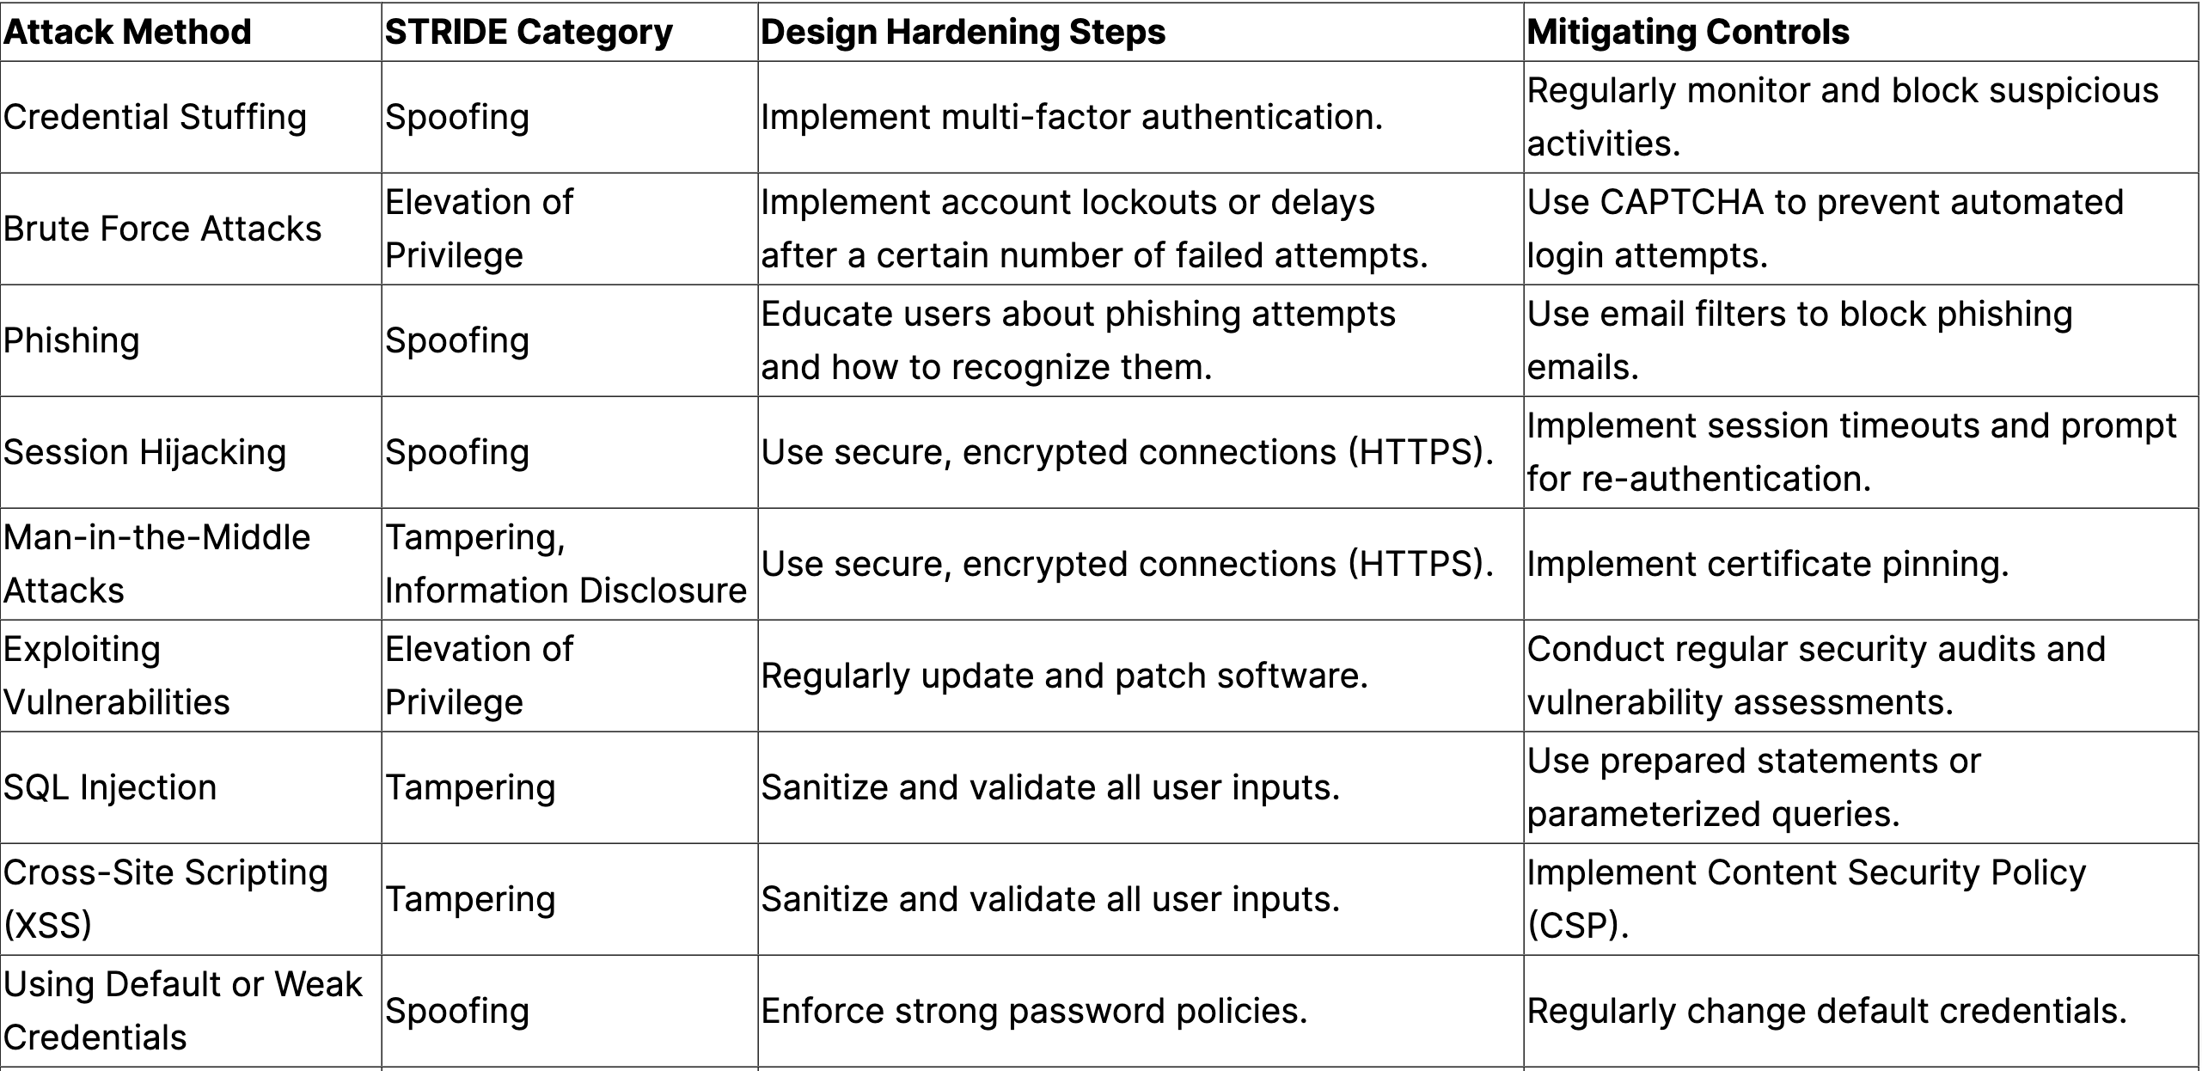
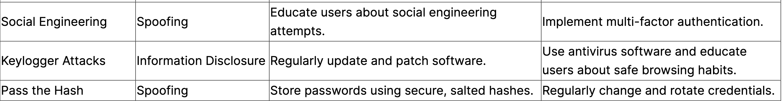

Slide 13
10 AuthN Bypass Attacks on APIs
Similarly, APIs are also subject to authentication bypass attacks. There are several ways in which authentication bypass can occur for an Application Programming Interface (API). Here are some common methods:
Insecure Direct Object References (IDOR): This occurs when an API exposes a reference to an internal implementation object. By manipulating these references, an attacker could gain unauthorized access to data.
Missing Authentication: If an API endpoint is not properly secured, it might be possible to bypass authentication entirely.
Brute Force Attacks: Attackers use software to try many password or token combinations until they find one that works.
Token Hijacking: If an attacker can intercept an API token (similar to a session cookie for a web service), they can impersonate that user.
Exploiting Vulnerabilities: Software bugs or misconfigurations can sometimes allow attackers to bypass authentication. For example, a bug in the way the API handles token expiration might allow an attacker to use an expired token.
Insecure Storage of API Keys/Tokens: If API keys or tokens are stored insecurely (e.g., in plain text or in a publicly accessible location), an attacker might be able to find and use them.
Man-in-the-Middle (MitM) Attacks: Attackers intercept and potentially alter communication between two parties without their knowledge.
Using Default or Weak API Keys: Many systems come with default API keys that are easily guessable if they aren’t changed. Similarly, weak or easily guessable keys can be exploited.
Insufficient Rate Limiting: Without proper rate limiting, an attacker can make many attempts to guess a password or token in a short amount of time.
Social Engineering: This involves manipulating people into breaking normal security procedures, such as revealing their API keys or other sensitive information.
The table below summarizes the authentication bypass attacks, their STRIDE classification, design hardening steps, and mitigating controls:

Slide 14
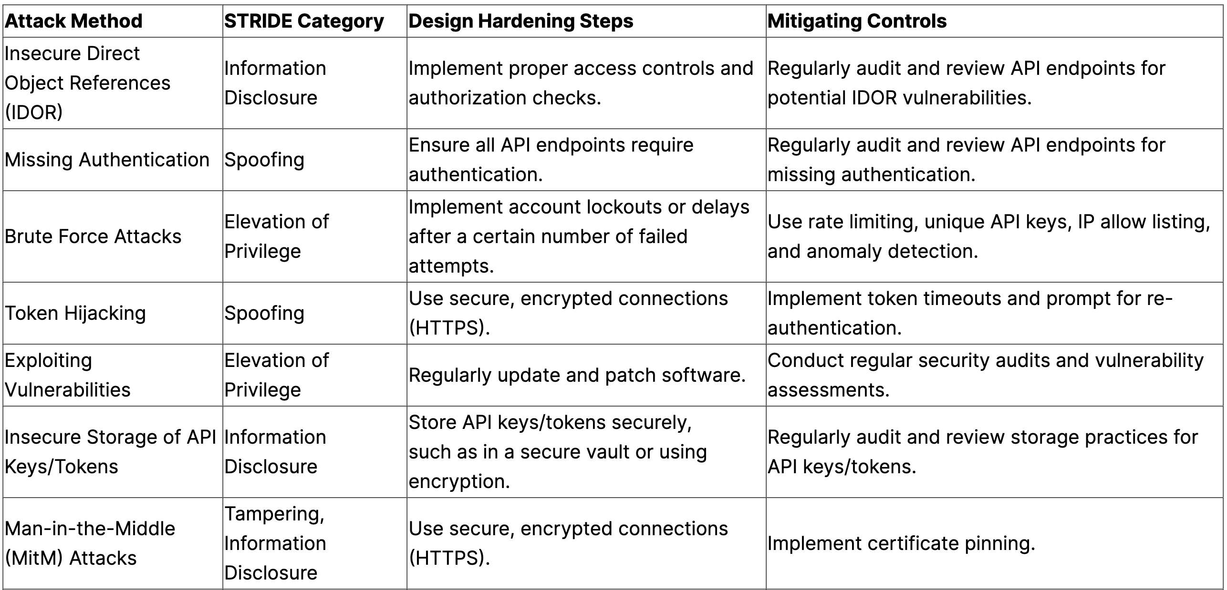

Slide 15
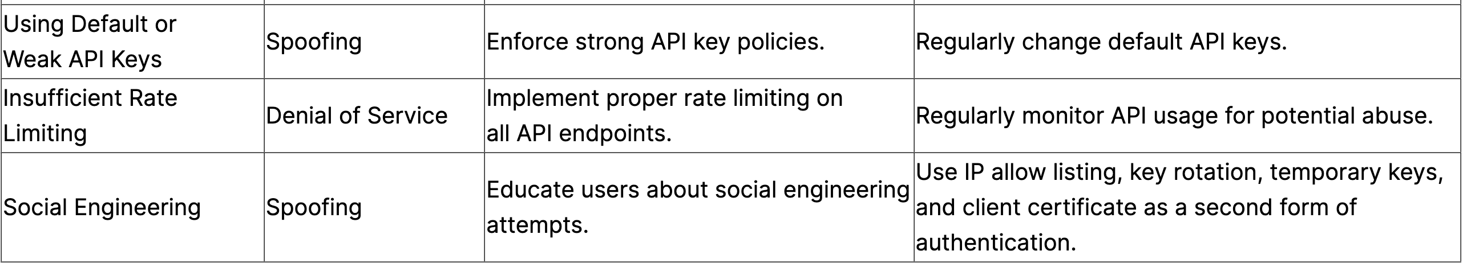
Authorization Bypass Attacks
Authorization bypass attacks on a web service occur when an attacker gains access to functions or data that they are not authorized to access. This can happen due to flaws in the way the web service checks permissions or other vulnerabilities that the attacker can exploit.
Here are some common types of authorization bypass attacks and their implications:
Insecure Direct Object References (IDOR): This occurs when an application provides direct access to objects based on user-supplied input. By manipulating these references, an attacker could gain unauthorized access to data. The implication is unauthorized data access, which could lead to data theft or manipulation.
Missing Function Level Access Control: Sometimes, an application might check permissions for a function at the UI level but not at the server level. An attacker could bypass the UI restrictions and directly call these server-side functions. The implication is unauthorized function access, which could lead to unauthorized actions being performed.
Forceful Browsing: This involves guessing the URL of restricted pages and accessing them directly. The implication is unauthorized page access, which could lead to unauthorized data access or actions.
Elevation of Privilege: If an application has a flaw that allows a user to elevate their privileges, they could gain access to functions or data that they are not authorized to access. The implication is unauthorized access at a higher privilege level, which could lead to significant data theft or manipulation.

Slide 16
Elevation of Privilege: If an application has a flaw that allows a user to elevate their privileges, they could gain access to functions or data that they are not authorized to access. The implication is unauthorized access at a higher privilege level, which could lead to significant data theft or manipulation.
Session Hijacking: If an attacker can steal a user’s session cookie, they might be able to impersonate that user and gain their authorizations. The implication is unauthorized access as a legitimate user, which could lead to significant data theft or manipulation.
Cross-Site Request Forgery (CSRF): An attacker could trick a user into performing actions they are authorized to do but didn’t intend to do. The implication is unauthorized actions being performed on behalf of a legitimate user, which could lead to data theft or manipulation.
Exploiting Vulnerabilities: Software bugs or misconfigurations can sometimes allow attackers to bypass authorization. For example, a bug in the way the application checks permissions could allow an attacker to bypass these checks. The implication is unauthorized access, which could lead to data theft or manipulation.
Parameter Manipulation: If an application uses parameters in the URL or hidden form fields to control access, an attacker could manipulate these to gain unauthorized access. The implication is unauthorized data access, which could lead to data theft or manipulation.
The implications of these attacks can be severe, including data theft, data manipulation, unauthorized actions being performed, and potential compliance violations. It’s important for web services to implement robust authorization checks and other security measures to prevent these types of attacks.

Slide 17
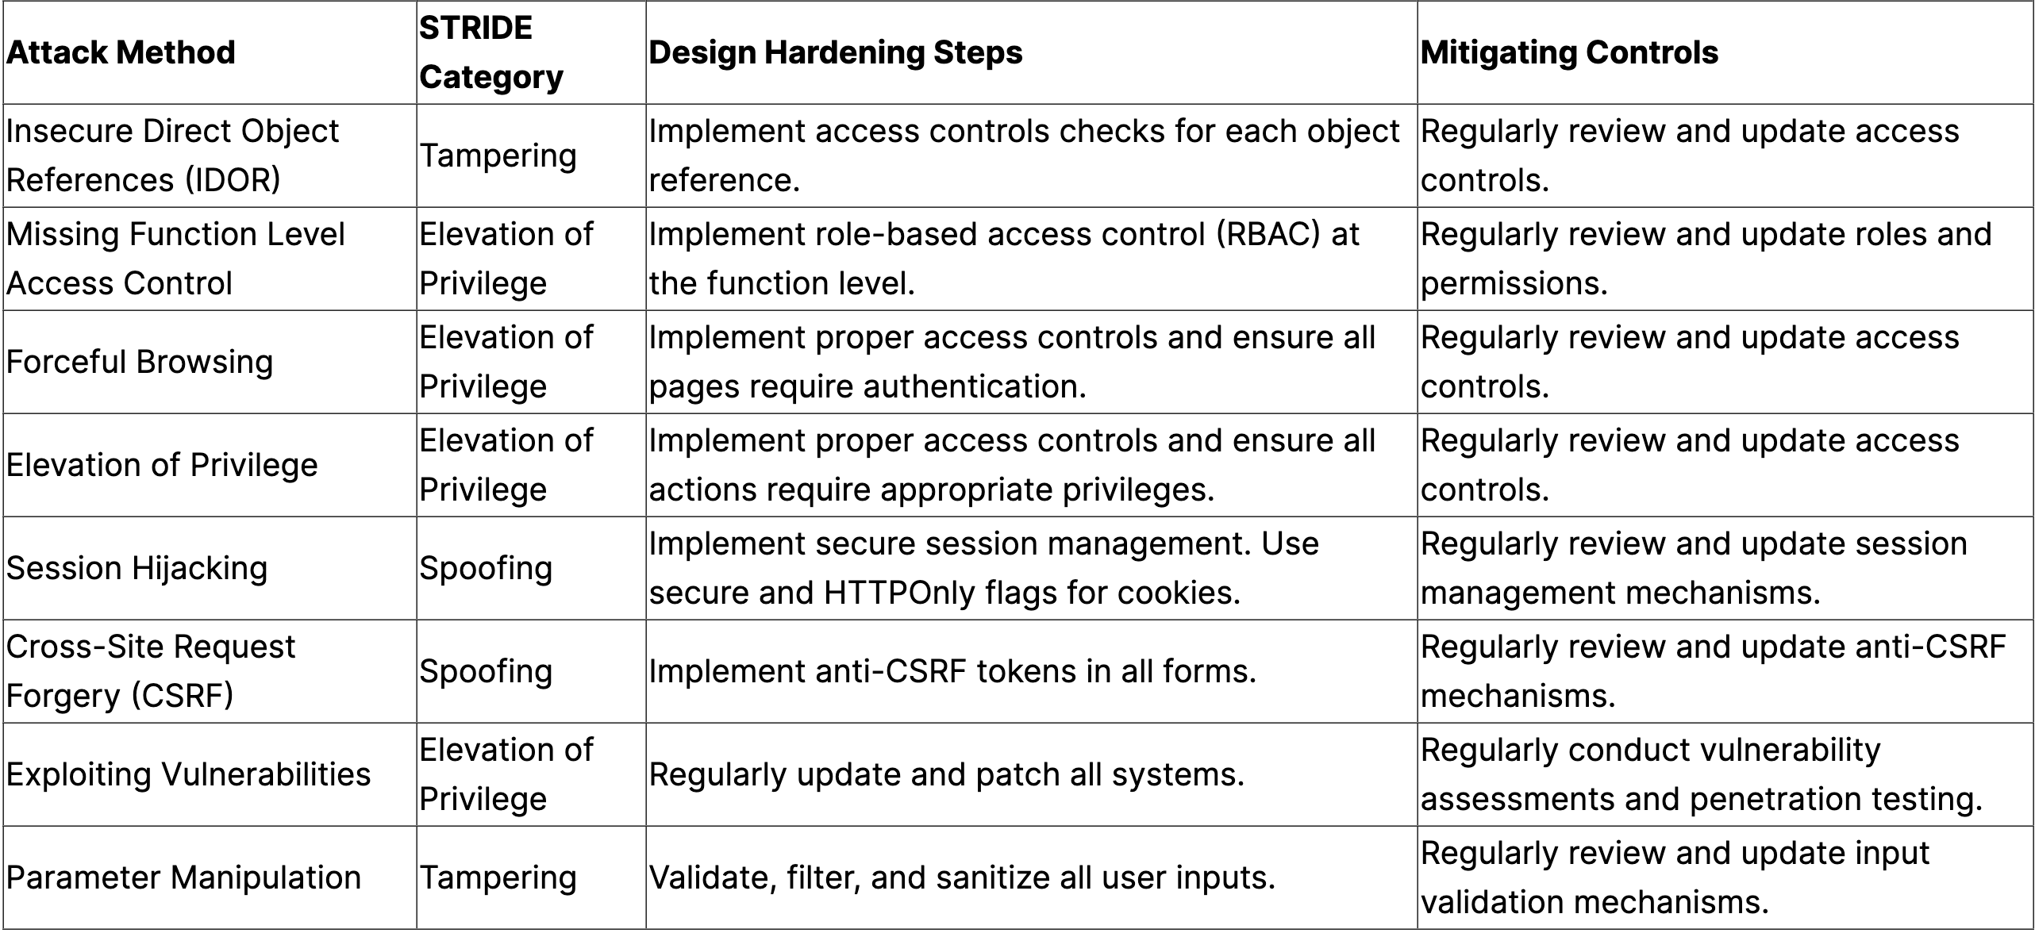

Slide 18
7 AuthZ Attacks on APIs
There are several ways in which an authorization bypass can occur for an API. Here are some common methods and their implications:
Insecure Direct Object References (IDOR): This occurs when an API exposes a reference to an internal implementation object. By manipulating these references, an attacker could gain unauthorized access to data. The implication is unauthorized data access, which could lead to data theft or manipulation.
Missing Function Level Access Control: Sometimes, an API might check permissions for a function at the UI level but not at the server level. An attacker could bypass the UI restrictions and directly call these server-side functions. The implication is unauthorized function access, which could lead to unauthorized actions being performed.
Forceful Browsing: This involves guessing the URL of restricted endpoints and accessing them directly. The implication is unauthorized endpoint access, which could lead to unauthorized data access or actions.
Elevation of Privilege: If an API has a flaw that allows a user to elevate their privileges, they could gain access to functions or data that they are not authorized to access. The implication is unauthorized access at a higher privilege level, which could lead to significant data theft or manipulation.
Token Hijacking: If an attacker can steal a user’s API token, they might be able to impersonate that user and gain their authorizations. The implication is unauthorized access as a legitimate user, which could lead to significant data theft or manipulation.
Exploiting Vulnerabilities: Software bugs or misconfigurations can sometimes allow attackers to bypass authorization. For example, a bug in the way the API handles token expiration might allow an attacker to use an expired token. The implication is unauthorized access, which could lead to data theft or manipulation.
Parameter Manipulation: If an API uses parameters in the URL or hidden form fields to control access, an attacker could manipulate these to gain unauthorized access. The implication is unauthorized data access, which could lead to data theft or manipulation.

Slide 19
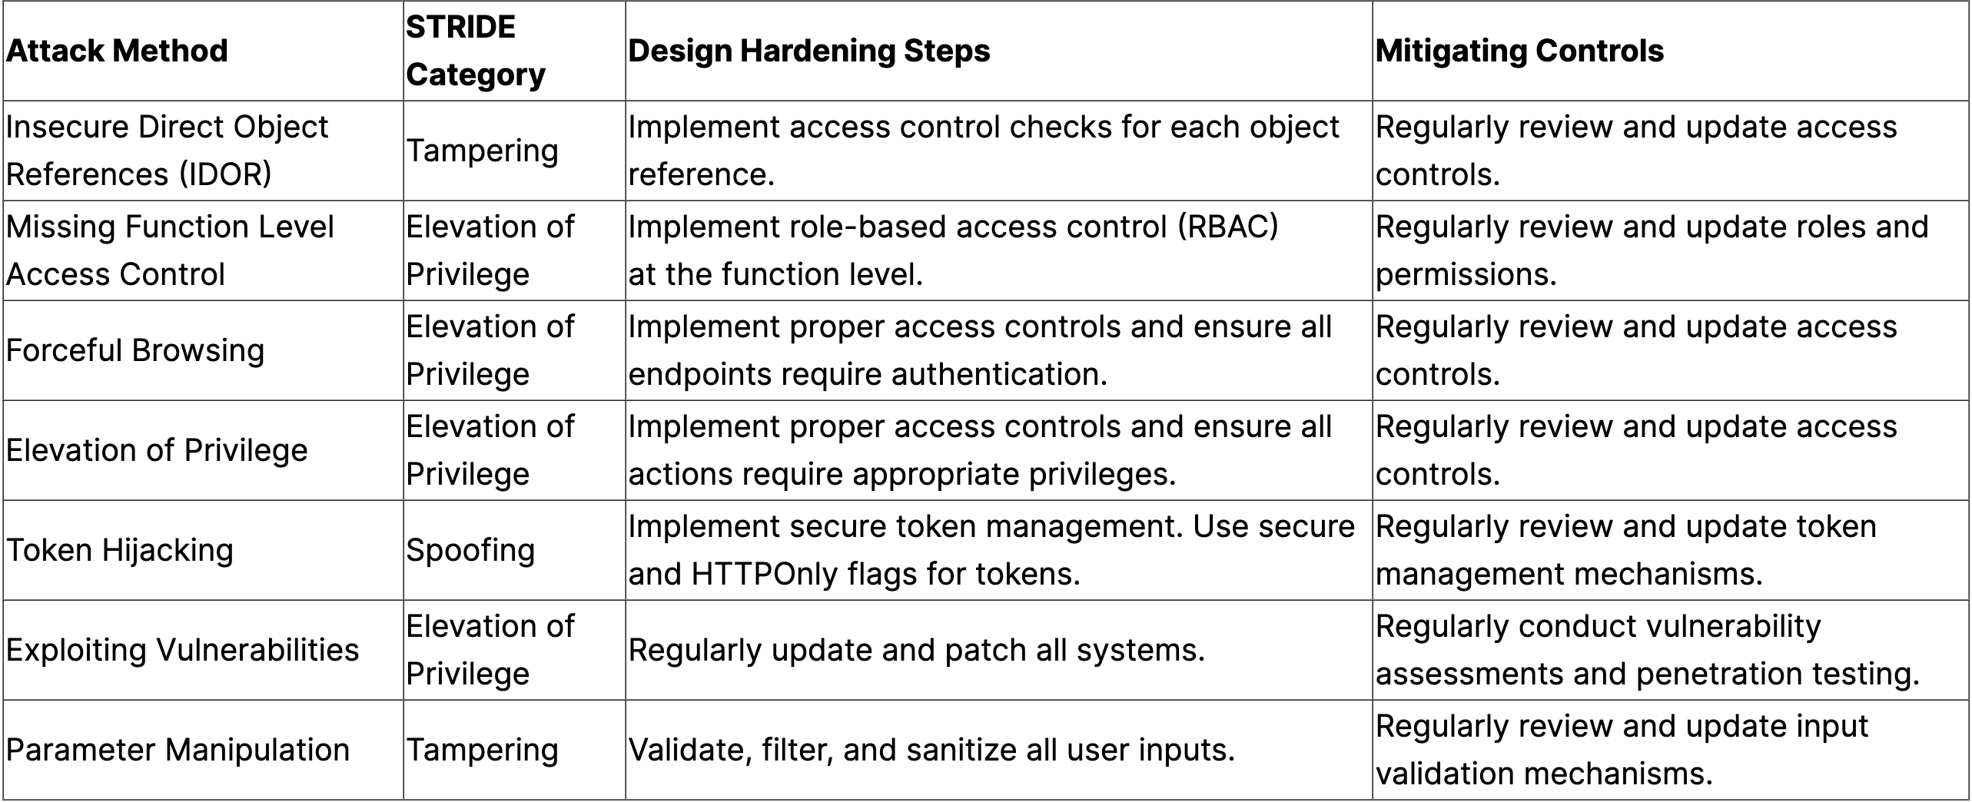
Sample Threat Modeling Exercise

Slide 20
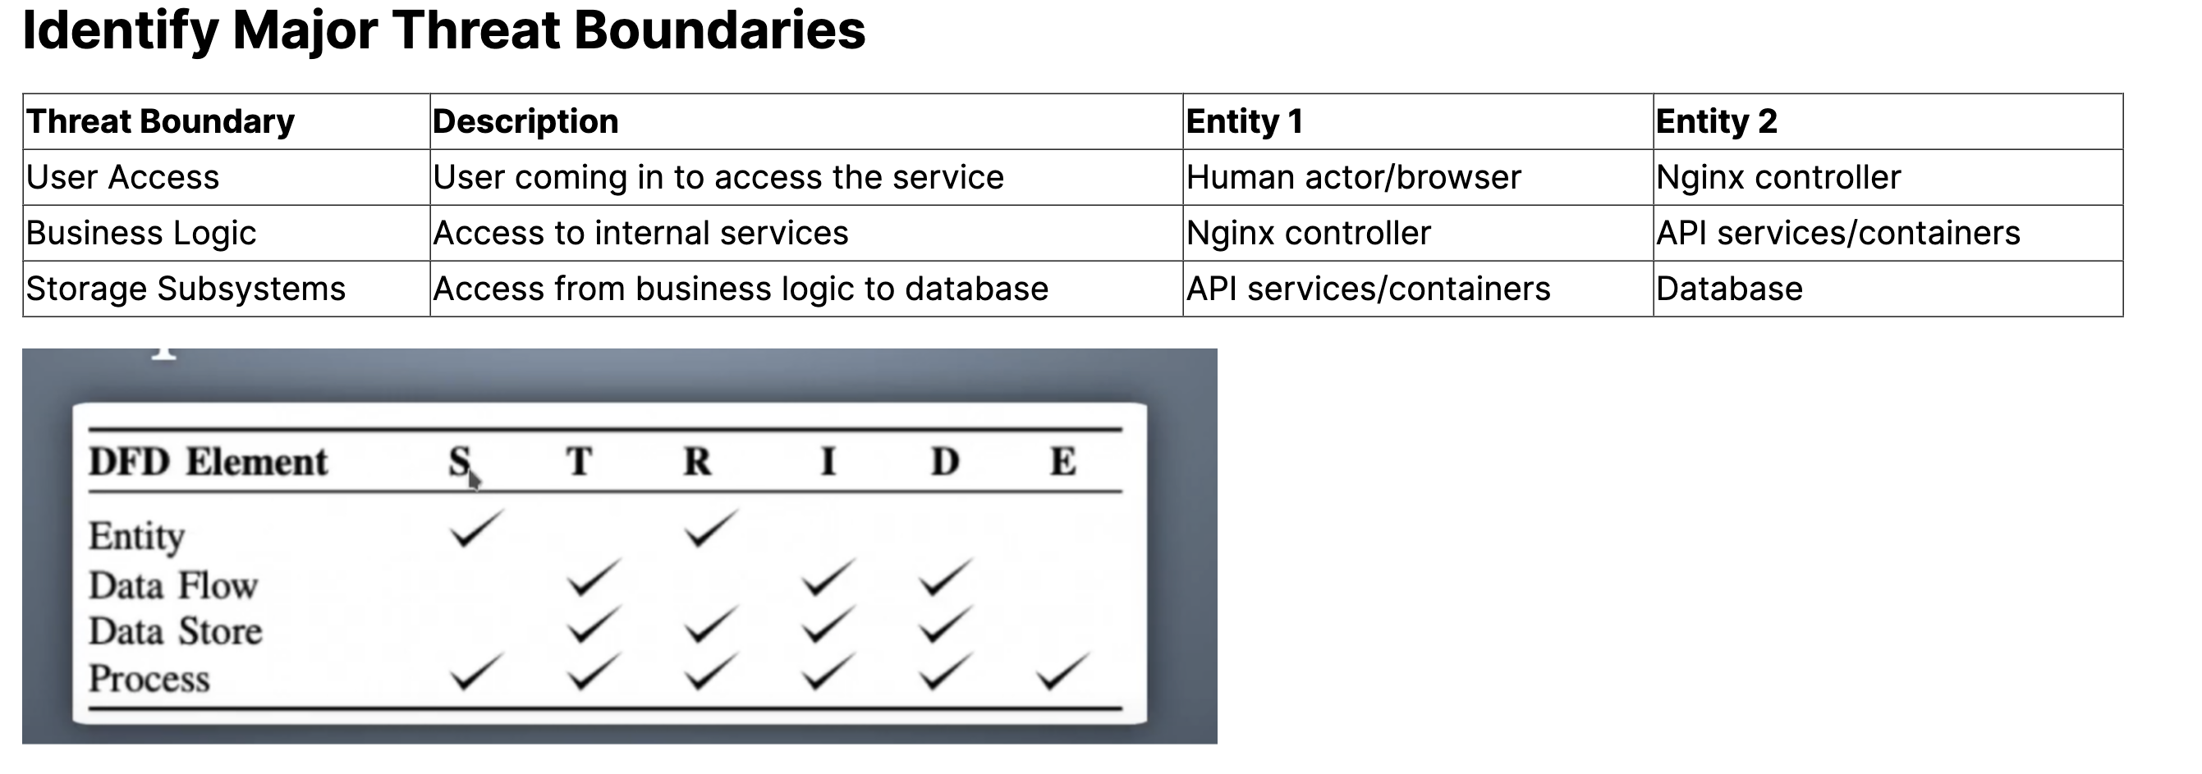

Slide 21
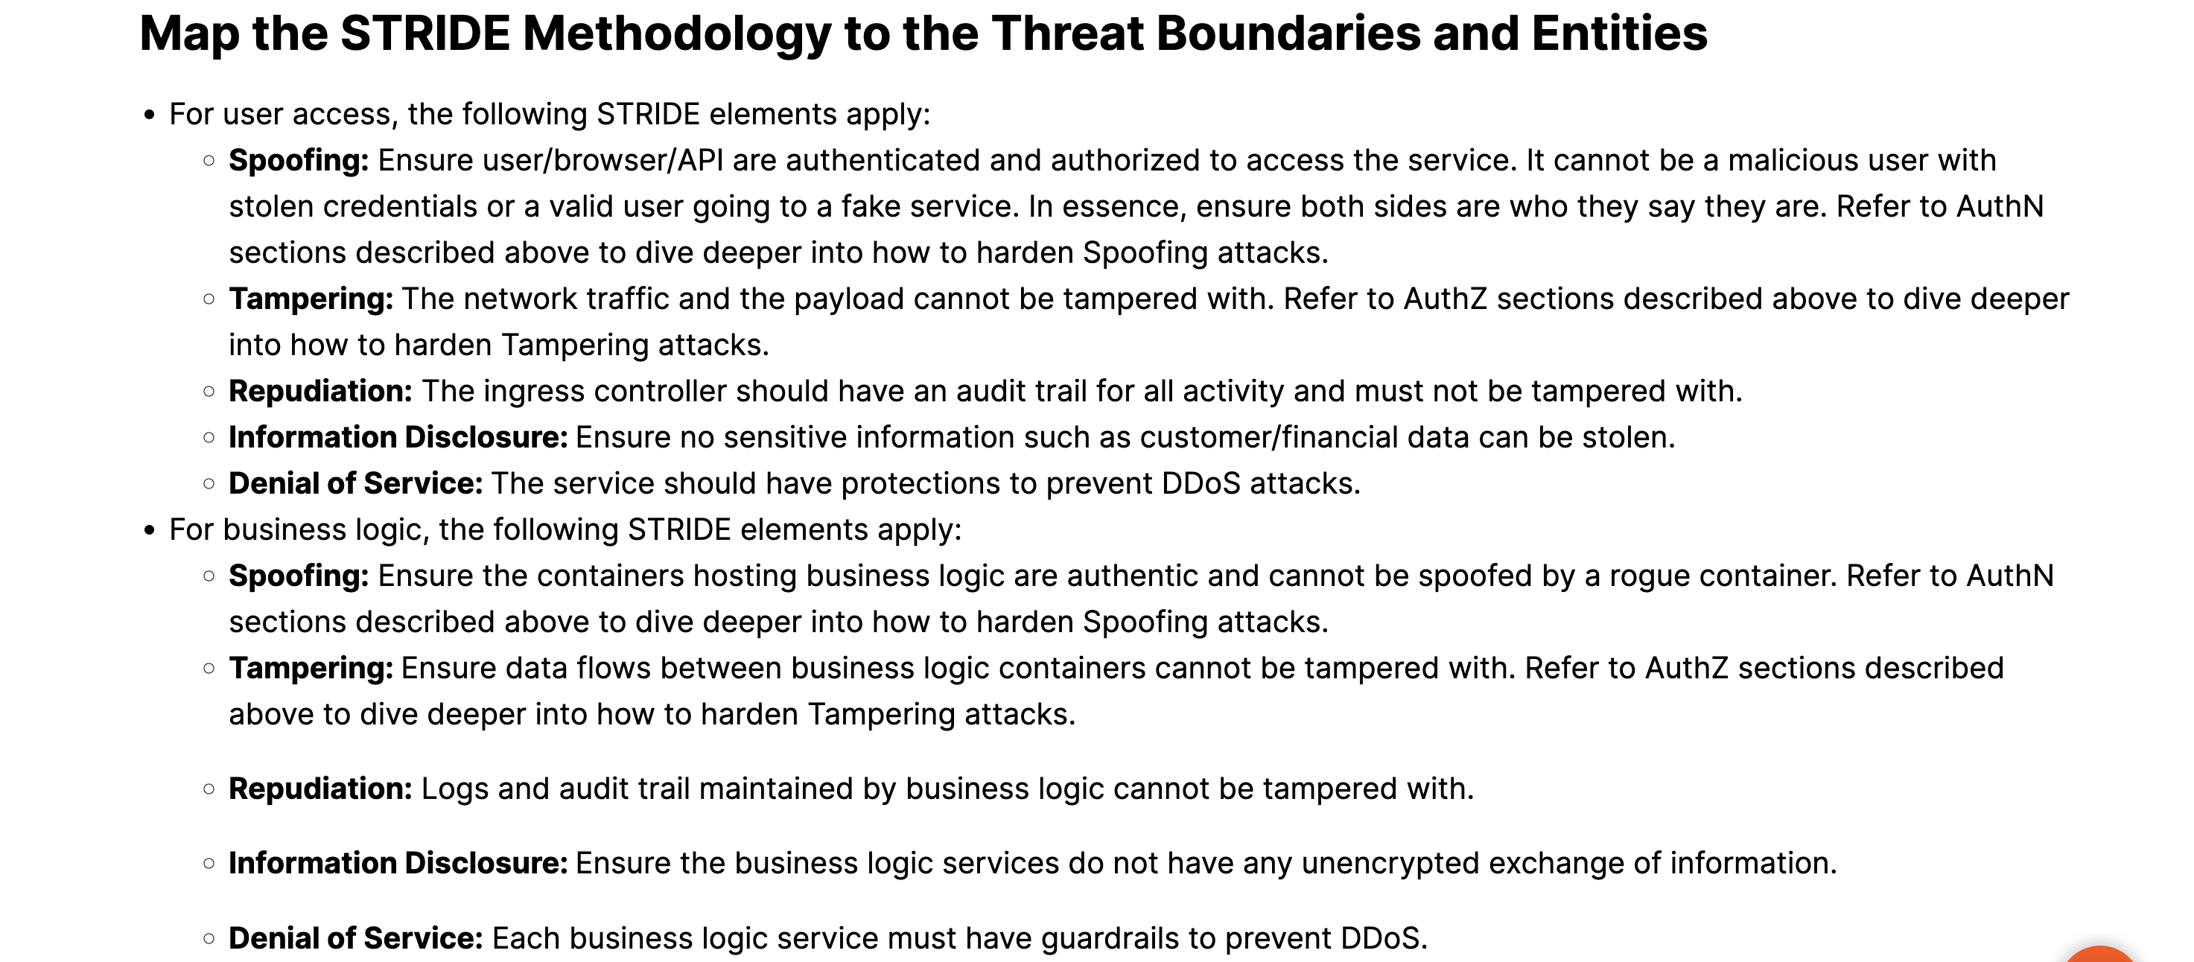

Slide 22
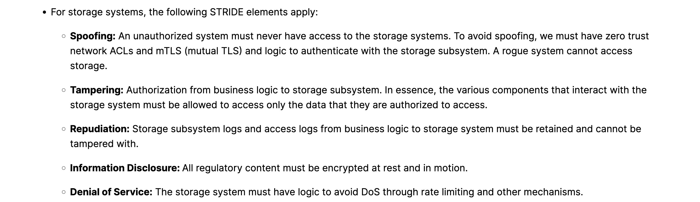

Slide 23
Best Practices to Follow Even Before Starting Threat Modeling
This is a lot and one must wonder if this is all automated or can one use available tools/platforms/storage systems that already take care of hardening the components one wants to use in their environment.
Use CIS-benchmarked components
Use CIS hardened containers, platforms (Kubernetes), AWS, databases/storage (Mongo, S3). For example, use a CIS hardened EKS for your Kubernetes platform if you’re running your services in AWS. The same applies to databases and storage platforms you plan to use in your design.
Use the following checklist to ensure cloud security controls are in place
FW (Botnet/DDoS): Network-specific firewall rules
IDPS: Intrusion detection prevention systems
Web application firewalls (WAF)
API security
Network (segmentation)
Logging to SPLUNK
Container and EC2 security
Kubernetes hardening as per CIS benchmark

Slide 24
OWASP Top 10 for web apps/APIs
Follow the best practices described in the OWASP Top 10 for ensuring apps and APIs are adhering to the guidelines set by the OWASP community. To summarize:
Implement authentication controls to prevent impersonation of users.
Restrict object and function access to prevent unauthorized data exposure.
Validate all inputs and sanitize data to stop injection attacks.
Use rate limiting and disable unnecessary methods to prevent DOS attacks.
Deprecate outdated APIs to avoid shadow surfaces vulnerable to attack and maintain up-to-date API protections against evolving OWASP threats.
Properly configure headers, error handling, and other settings to block misconfiguration risks.
Monitor activity closely with detailed logging for early breach detection.
Follow general secure coding practices like avoiding mass assignment of user inputs.
Limit data exposure only to authorized users to prevent access abuse.
Guard against object/ID manipulation that could enable data exploits.
https://owasp.org/www-project-top-ten/
https://blog.purestorage.com/purely-technical/national-coding-week-upskill-your-coding-knowledge-with-pure-storage/

Slide 25
Conclusion
Threat modeling has become essential for building secure software, yet many organizations still do not practice it regularly. This needs to change.
Threat modeling provides tangible benefits across the software development lifecycle. Architects can design more secure systems knowing the high-risk areas early. Developers can code defensively against potential threats. Security teams gain confidence that risks are proactively addressed. Organizations face lower costs from dealing with fewer incidents later on.
While various techniques exist, STRIDE provides a straightforward methodology to apply threat modeling in a structured way. Mapping threats to boundaries, assets, and components enables methodical risk analysis and mitigation planning. Integrating threat modeling sessions into existing design and code reviews institutionalizes it without requiring wholesale process changes.
However, threat modeling is not a solo activity done in silos. Collaboration between security and development teams is key to building a robust threat model. Cross-functional engagement results in more insights, rapid feedback, and improved solutions. Integrate threat modeling into your SDLC by:
Scheduling regular threat modeling working sessions
Making threat models and mitigation requirements visible
Providing threat modeling training and guidance
Updating models continuously as designs evolve
With a collaborative culture of “security by design,” organizations can build more resilient software, gain visibility into risks, and prevent incidents proactively. The increasing threat landscape makes threat modeling too important to overlook any longer. The time to institutionalize it is now.

Slide 26
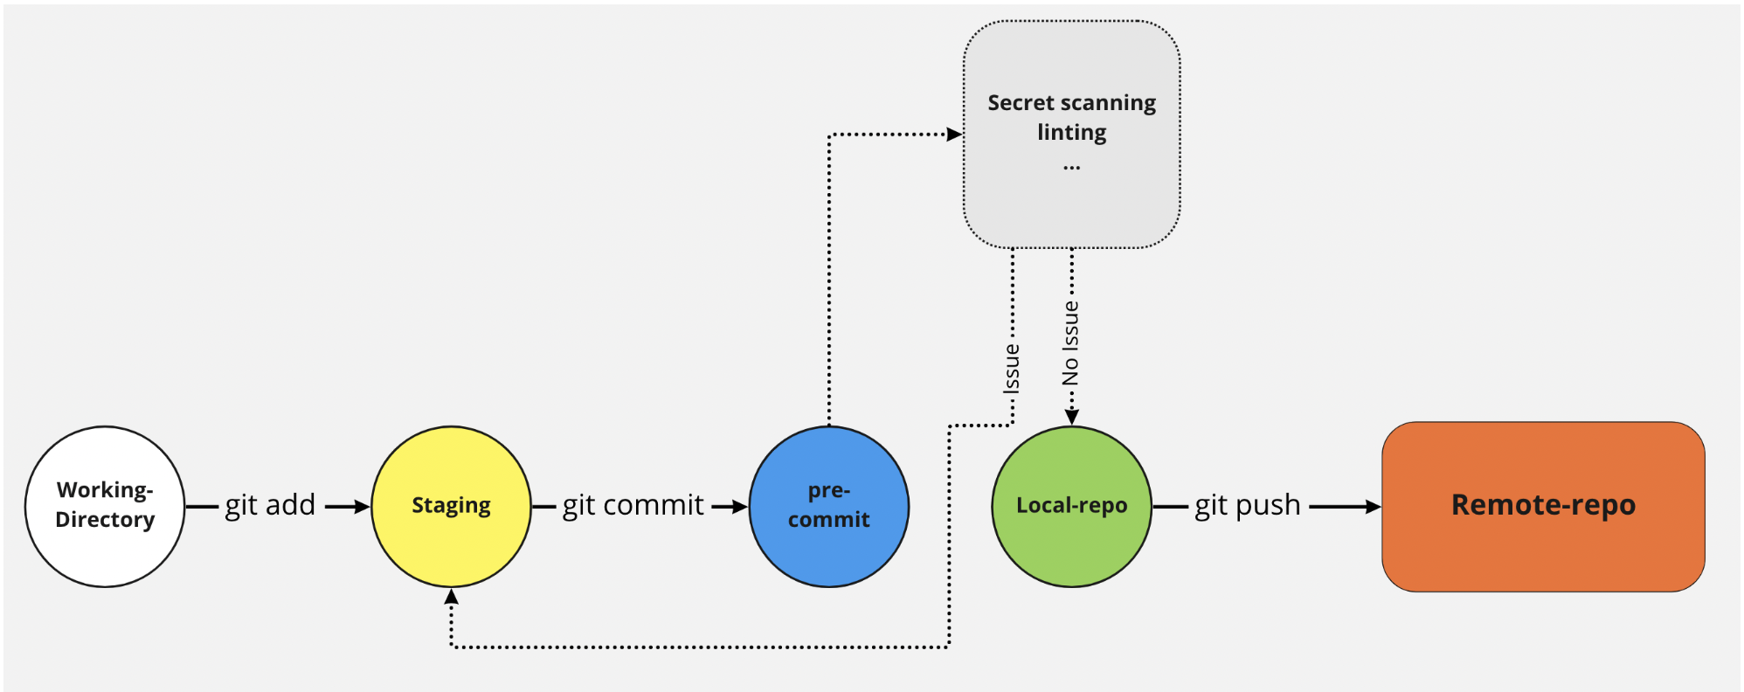
Pre-commit
The Pre-commit fase is important because it can prevent security issues before they are submitted to a central (Git) repository.
Making sure that there are no secrets in the code, and that the code follows certain guidelines (According to the Linter rules) will result in a higher quality code.
In the following, we take a look into different types of pre-commit actions that are as follows:
Secrets Management
Linting Code
The following image can give you a better view of what the pre-commit means and why we must consider it.

Slide 27
Pre-commit
The Pre-commit fase is important because it can prevent security issues before they are submitted to a central (Git) repository.
Making sure that there are no secrets in the code, and that the code follows certain guidelines (According to the Linter rules) will result in a higher quality code.
In the following, we take a look into different types of pre-commit actions that are as follows:
Secrets Management
Linting Code
The following image can give you a better view of what the pre-commit means and why we must consider it.
Tools:
Pre-Commit - A framework for managing and maintaining multi-language pre-commit hooks.
https://pre-commit.com/

Slide 28
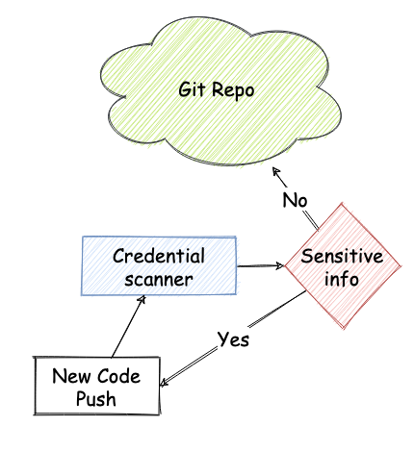
Secrets Management
Take care secrets and credentials in repositories
How can you ensure that sensitive information are not pushed to a repository?
This is one of the OWASP Top Ten issues and several bug bounties write-ups are related to this kind of issue, eg hard-coded credentials pushed by mistake.
You should scan your commits and your repository, and detect any sensitive information such as password, secret key, confidential, etc. following the process shown in the picture.
The ideal approach is detecting and preventing the exposure of sensitive data before that they hit the repository, because they are then visible in the history. In case of code hosting platforms, secrets can still linger on the web and be searchable after you remove them from the repository.
A complimentary approach is scanning the repo for sensitive information, and then remove them; note that when a credential is leaked, it is already compromised and should be invalidated.

Slide 29
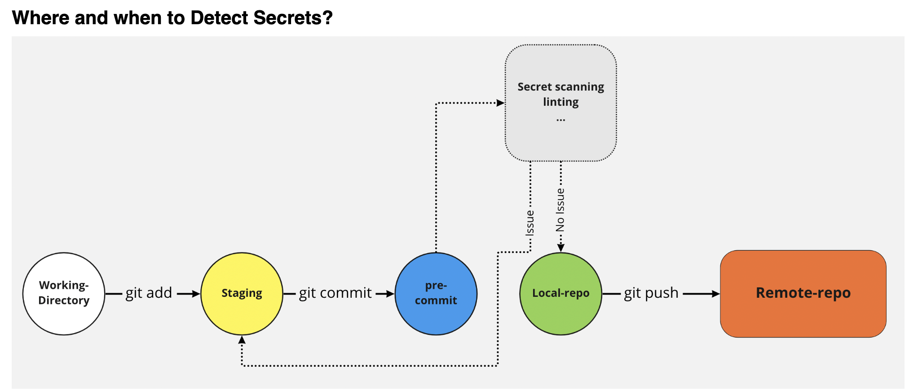
Detecting secrets in several locations
Detecting existing secrets by searching in a repository for existing secrets.
Using Pre-commit hooks in order to prevent secrets for entering our code base.
Detecting secrets in a pipeline .
Why Detecting Secrets?
The secrets should not be hardcoded.
The secrets should not be unencrypted.
The secrets should not be stored in source code.
The code history does not contain inadvertent secrets.

Slide 30
Well, the best location is the pre-commit location, This ensure that before a secret actually enters your code base, it is intercepted, and the developer or to committer gets a message. Another location is the build server or the build process. The build server retrieves source code, which is already committed and then it can analyze the source code where it contains new secrets or when it contains known secrets that the secrets are actually validated or audited.
Here are some helpful tools to automatically scan repositories for sensitive information. Scans can be implemented directly in our pipeline, and be repeatable and efficient.
Tools:
gittyleaks - Find sensitive information for a git repo
git-secrets - Prevents you from committing secrets and credentials into git repositories
Repo-supervisor - Scan your code for security misconfiguration, search for passwords and secrets
truffleHog - Searches through git repositories for high entropy strings and secrets, digging deep into commit history
Git Hound - Git plugin that prevents sensitive data from being committed
https://github.com/kootenpv/gittyleaks
https://github.com/awslabs/git-secrets
https://github.com/auth0/repo-supervisor
https://github.com/trufflesecurity/trufflehog
https://github.com/ezekg/git-hound

Slide 31
Linting Code
What Is Linting?
Linting is the automated checking of your source code for programmatic and stylistic errors. This is done by using a lint tool (otherwise known as linter). A lint tool is a basic static code analyzer.
What can Linting do?
Linting can detect errors in a code and errors that can lead to a security vulnerabilities.
Linters Can Also detect formatting or styling issues and makes the code more readable for more secure code.
Linters can suggest best practices.
Also they can increases overall quality of the code.
Since everybody follows the same linting rules it makes maintenance of code easier.
Basic Lint Tools
Lint tools are the most basic form of static analysis. Using lint tools can be helpful for identifying common errors, such as:
Indexing beyond arrays
Dereferencing null pointers.
(Potentially) dangerous data type combinations.
Unreachable code.
Non-portable constructs.

Slide 32

Advanced Static Analysis Tools
Advanced static analysis tools typically deliver:
Pattern-based simulation.
Quality and complexity metrics.
Best practice recommendations for developers.
Support for multiple safety and security-focused coding standards.
Out-of-the-box certification for use in the development of safety-critical applications.
Issues with Linters
Not every language has “quality” standard linter tools available, each framwork usually has one or several linters.
Different versions or configurations can lead to different results.
Since some linters are very verbose and information overload can lead to focusing on “unimportant” issues.
Where and When to Use Linter

Slide 33
You can perform it in the pre-commit phase, so locally before actually committing code to your local repository to your local clone. Another phase where you often see linting is during the build phase, So here the build server pulls the code from the Git repository and performs linting on it and reports back that results from linting phase.
References
Preforce
https://www.perforce.com/blog/qac/what-is-linting
Vulnerability Scanning
Vulnerability scanning is an inspection of the potential points of exploit on a computer, application, endpoints, and IT infrastructure (including network) to identify security holes.
Performing vulnerability scanning is a common requirements for regulatory compliance and can help to minimize an organization’s cybersecurity risk. An Approved Scanning Vendor (ASV), for example, is a service provider that is certified and authorized by the Payment Card Industry (PCI) to scan payment card networks.
In the following, we take a look into different types of vulnerability scanning that are as follows:
Static Application Security Test - SAST
Dynamic Application Security Test - DAST
Interactive Application Security Testing - IAST
Software Composition Analysis - SCA
Infrastructure Vulnerability Scanning
Continer Vulnerability Scanning

Slide 34
References
Wikipedia - Vulnerability Scanner
Techtarget - Vulnerability Scanning
Checkpoint - Vulnerability Scanning
https://en.wikipedia.org/wiki/Vulnerability_scanner
https://www.techtarget.com/searchsecurity/definition/vulnerability-scanning
https://www.checkpoint.com/cyber-hub/network-security/what-is-vulnerability-scanning/
Static scanning is an important part of the proces!(SAST)
Static Code Analysis or Source Code Analysis is usually part of a Code Review (white-box testing) and it is a method of computer program debugging that is done by examining the code without executing the program.
Static scanning is good way finding coding issues such as:
Syntax violations
Security vulnerabilities
Programming errors
Coding standard violations
Undefined values
For more information about the Static Code Analysis please visit the OWASP page To achieve a better result we can combine static security scanning and 3rd party code (open-source libraries (dependency)) scanning. To doing this part better and more complete (prevent misconfigurations), here we can bring up IaC (Infrastructure as code) security scan too. For example check Terraform, helm, Ansible code, etc. So according to the above lines the possible actions in this step are as follows:

Slide 35
Static Code Analysis (known as SAST)
Open-source libraries (3rd party / dependency) scanning (known as SCA)
IaC Security scanning
Tools
Static Code Analysis:
SonarQube - An open-source web-based tool, extending its coverage to more than 20 languages, and also allows a number of plugins
Veracode - A static analysis tool that is built on the SaaS model. This tool is mainly used to analyze the code from a security point of view
security code scan - Vulnerability Patterns Detector for C# and VB.NET
Brakeman - A static analysis security vulnerability scanner for Ruby on Rails applications
Enlightn - A static analysis vulnerability scanner for Laravel PHP applications
Inquisition - A set of tools for convenient technical analysis of web applications built with Ruby and Ruby on Rails. Now you don’t need to set up and configure every single gem. Use Inquisition gem instead
CodeSweep - Static Analysis tool for GitHub that’s free to use and can scan code on pull request. Support over 20 languages and IaC (docker, k8s). VS Code version can be found here
HCL AppScan on Cloud - SAST tool built as a service. The tool can perform traditional SAST, SCA and IaC scanning.
Semgrep - Lightweight static analysis for many languages. Find bug variants with patterns that look like source code.
Checkmarx SAST - A static analysis security vulnerability scanner
Fortify- A static analysis security vulnerability scanner

Slide 36
IaC scanning:
Checkov - Prevent cloud misconfigurations during build-time for Terraform, Cloudformation, Kubernetes, Serverless framework and other infrastructure-as-code-languages with Checkov by Bridgecrew
ansible-lint - Best practices checker for Ansible
puppet-lint - Check that your Puppet manifests conform to the style guide
tfsec - Security scanner for your Terraform code
terrascan - Detect compliance and security violations across Infrastructure as Code to mitigate risk before provisioning cloud native infrastructure
tflint - A Pluggable Terraform Linter
https://owasp.org/www-community/controls/Static_Code_Analysis
Dynamic Application Security Testing (DAST)
DAST is a “Black-Box” testing, can find security vulnerabilities and weaknesses in a running application by injecting malicious payloads to identify potential flaws that allow for attacks like SQL injections or cross-site scripting (XSS), etc. DAST tools are especially helpful for detecting:
Input or output validation
Authentication issues
Server configuration mistakes

Slide 37
DAST tools allow for sophisticated scans on the client side and server side without needing the source code or the framework the application is built on. They usually require minimal user interactions once configured and can be run as part of a nightly scan. As more important DAST tools we can look at the following:
Dynamic security scanner
Fuzzers
Attack Proxies
Tools
Open-source:
ZED Attack Proxy - It is an open source tool which is offered by OWASP for performing security testing
Commercial:
Acunetix - An automatic web security testing scanner that accurately scans and audits all web applications, including HTML5, JavaScript and Single Page applications (SPAs)
Netsparker - It can identify vulnerabilities in all types of modern web applications, regardless of the underlying architecture or platform
InsightAppSec (AppSpider) - Application security testing for the modern web
Veracode Dynamic Analysis - Veracode Dynamic Analysis helps companies scan their web applications for exploitable vulnerabilities at scale
Burp Suite is an integrated platform for performing security testing of web applications. Its various tools work seamlessly together to support the entire testing process, from initial mapping and analysis of an application’s attack surface, through to finding and exploiting security vulnerabilities.
HCL AppScan on Cloud - DAST tool built as a service. It can scan both public and privatly hosted application. Can explore and test modern web applications, leverage manually recorded steps and handle complex login scenarios.
Nuclei - Fast and customisable vulnerability scanner based on simple YAML based DSL.

Slide 38
References
OWASP - Vulnerability Scanning Tools
RAPID7 - Dynamic Application Security Testing
https://owasp.org/www-community/Vulnerability_Scanning_Tools
https://www.rapid7.com/fundamentals/dast/
Interactive Application Security Testing(IAST)
IAST (interactive application security testing) is an application security testing method that tests the application while the app is run by an automated test, human tester, or any activity “interacting” with the application functionality.
The core of an IAST tool is sensor modules, software libraries included in the application code. These sensor modules keep track of application behavior while the interactive tests are running. If a vulnerability is detected, an alert will be sent.
The process and feedback are done in real time in your integrated development environment (IDE), continuous integration (CI) environment, or quality assurance, or while in production. The sensors have access to:
Entire code
Dataflow and control flow
System configuration data
Web components
Back-end connection data
Examples of such vulnerabilities could be hardcoding API keys in cleartext, not sanitizing your users inputs, or using connections without SSL encryption.

Slide 39
IAST vs SAST
Static Application Security Testing method examine source code in a non-runtime environment early in the SDLC.
They look for suspicious code patterns that indicate security risks. Even though they are easy to deploy, SASTs throw too many false positives because SASTs do not take into account the presence of other security countermeasures, and they lack visibility during runtime. SAST tools normally run inside the IDE as part of the compilation phase, and introduce delays as the scan process takes time to finish. IASTs are more flexible than SASTs, because they are applicable in production runtime environments (SASTs require direct access to the source code).
IAST vs DAST
Dynamic Application Security Testing method is works like a black-box scanner that executes requests against the application to find security issues. DASTs look at the applications from the exterior and determine the presence of risks by looking at the response (including body and headers) of the server to a battery of tests, but DASTs have no visibility of the internal workings of the app. Furthermore, DAST tests are hard to automate, because DASTs must be operated by experienced appsec teams, such as penetration testers, to be truly useful. Forrester estimates that the duration of a DAST scan can take around 5 to 7 days, while testing with IAST is a real-time (zero minutes) operation.
Tools
Contrast Community Edition (CE)
Checkmarx Interactive Application Security Testing(CxIAST)
Seeker Interactive Application Security Testing
HCL AppScan on Cloud
References
Veracode - IAST
OWASP - Free for Open Source Application Security Tools
Hdivsecurity - IAST
Contrastsecurity - IAST
Synk - IAST
Acunetix - IAST
Contrast - Why the difference sast, dast, and iast mastters
Esecurityplanet - Application security vendors

Slide 40
Software Component/Composition Analysis (SCA)
Component Analysis is the process of automating application security for managing third-party and open source components of codebase. SCA will find any potential vulnerable components in our codebase to prevent high security risks like Supply-Chain Attack, not only that but also provide licensing about each components. By doing this, it helps organization to reduce security risks in their codebase libraries and needed to be early in modern software development life cycle.
https://owasp.org/www-community/Component_Analysis
We should put the Component Analysis earlier, before security testing like SAST, DAST to prevent any vulnerable libraries pushed to live environment (Production) and implemented Continuous Monitoring of its libraries to reduce Supply Chain Attack risk rapidly.
Tools
Open-source:
OWASP Dependency-check - Software Composition Analysis (SCA) tool that attempts to detect publicly disclosed vulnerabilities contained within a project’s dependencies and it supports Java, .NET, JavaScript, Ruby
RetireJS - JavaScript-specific dependency checker
Safety - Python dependency checker for known security vulnerabilities
bundler-audit - Patch-level verification for Bundler (Auditing Ruby 3rd party libs versions)
Commercial:
Hakiri - A commercial tool that offers dependency checking for Ruby and Rails-based GitHub projects using static code analysis
HCL AppScan on Cloud - SAST tool built as a service that can perform both SAST, SCA & IaC at the same time.
Snyk - SCA tool offer as a SaaS solution.
WhiteSource - WhiteSource identifies every open source component in your software, including dependencies. It then secures you from vulnerabilities and enforces license policies throughout the software development lifecycle.
Synopsys BlackDuck - Black Duck automated policy management allows you to define policies for open source use, security risk, and license compliance up front, and automate enforcement across the software development life cycle (SDLC).
References
SCA - OWASP

Slide 41
Infrastructure Vulnerability Scanning(IasC)
DevOps does a great job in automating the development and deployment process, but since all moving parts (containers, libraries etc.) are being updated frequently, it is imperative to make sure the infrastructure where you deploy your code is safe.
The best way to do that is to incorporate vulnerability scanning into your pipeline.
A vulnerability scanner is a computer program designed to assess computers, networks or applications for known weaknesses. These scanners are used to discover the weaknesses of a given system. They are utilized in the identification and detection of vulnerabilities arising from mis-configurations or flawed programming within a network-based asset such as a firewall, router, web server, application server, etc. Modern vulnerability scanners allow for both authenticated and unauthenticated scans. Modern scanners are typically available as SaaS (Software as a service); provided over the internet and delivered as a web application. The modern vulnerability scanner often has the ability to customize vulnerability reports as well as the installed software, open ports, certificates and other host information that can be queried as part of its workflow.
Authenticated scans allow for the scanner to directly access network based assets using remote administrative protocols such as secure shell (SSH) or remote desktop protocol (RDP) and authenticate using provided system credentials. This allows the vulnerability scanner to access low-level data, such as specific services and configuration details of the host operating system. It’s then able to provide detailed and accurate information about the operating system and installed software, including configuration issues and missing security patches.
Unauthenticated scans is a method that can result in a high number of false positives and is unable to provide detailed information about the assets operating system and installed software. This method is typically used by threat actors or security analyst trying determine the security posture of externally accessible assets.

Slide 42
Tools
SAINT (Security Administrator’s Integrated Network Tool) is computer software used for scanning computer networks for security vulnerabilities, and exploiting found vulnerabilities.
Nessus scans cover a wide range of technologies including operating systems, network devices, hypervisors, databases, web servers, and critical infrastructure.
Arachni is a Web Application Security Scanner Network that could be used to scan the vulnerability such a XSS, SQL Injection, NoSQL Injection, Code Injection, File Inclusion variants, etc.
Burp Suite is an integrated platform for performing security testing of web applications. Its various tools work seamlessly together to support the entire testing process, from initial mapping and analysis of an application’s attack surface, through to finding and exploiting security vulnerabilities.
Nexpose is one of the main vulnerability evaluation tools which provides a simple to-utilize, useful dashboard, and, as the vast majority of the tools we have seen, it bolsters a broad scope of consistency reporting, including PCI compliance.
Nikto is a free software command-line vulnerability scanner that scans webservers for dangerous files/CGIs, outdated server software and other problems.
References
Wikipedia - Vulnerability Scanner
Techtarget - Vulnerability Scanning
OWASP - Vulnerability Scanning Tools
Checkpoint - Vulnerability Scanning

Slide 43
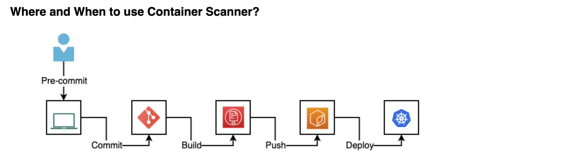
Container Vulnerability Scanning
As containers become an almost ubiquitous method of packaging and deploying applications, the instances of malware have increased. Securing containers is now a top priority for DevOps engineers. Fortunately, a number of open source programs are available that scan containers and container images. Let’s look at five such tools
What can Container Security Scanning do?
Detect insecure containers
Detect outdated libraries
Detect incorrectly configured containers
Detect outdated operating system
Detect compliance validations
Suggest best practices
Issues with Container Security Scanner
Level of depth depends on tool being used, So the results that you’ll get are very dependent on the type of tool you choose.
Easy to go “too far” with configuration, there are tools where you can configure so much different settings, that it’s easy to jump overboard.
The scan results will lead to actionable events?

Slide 44
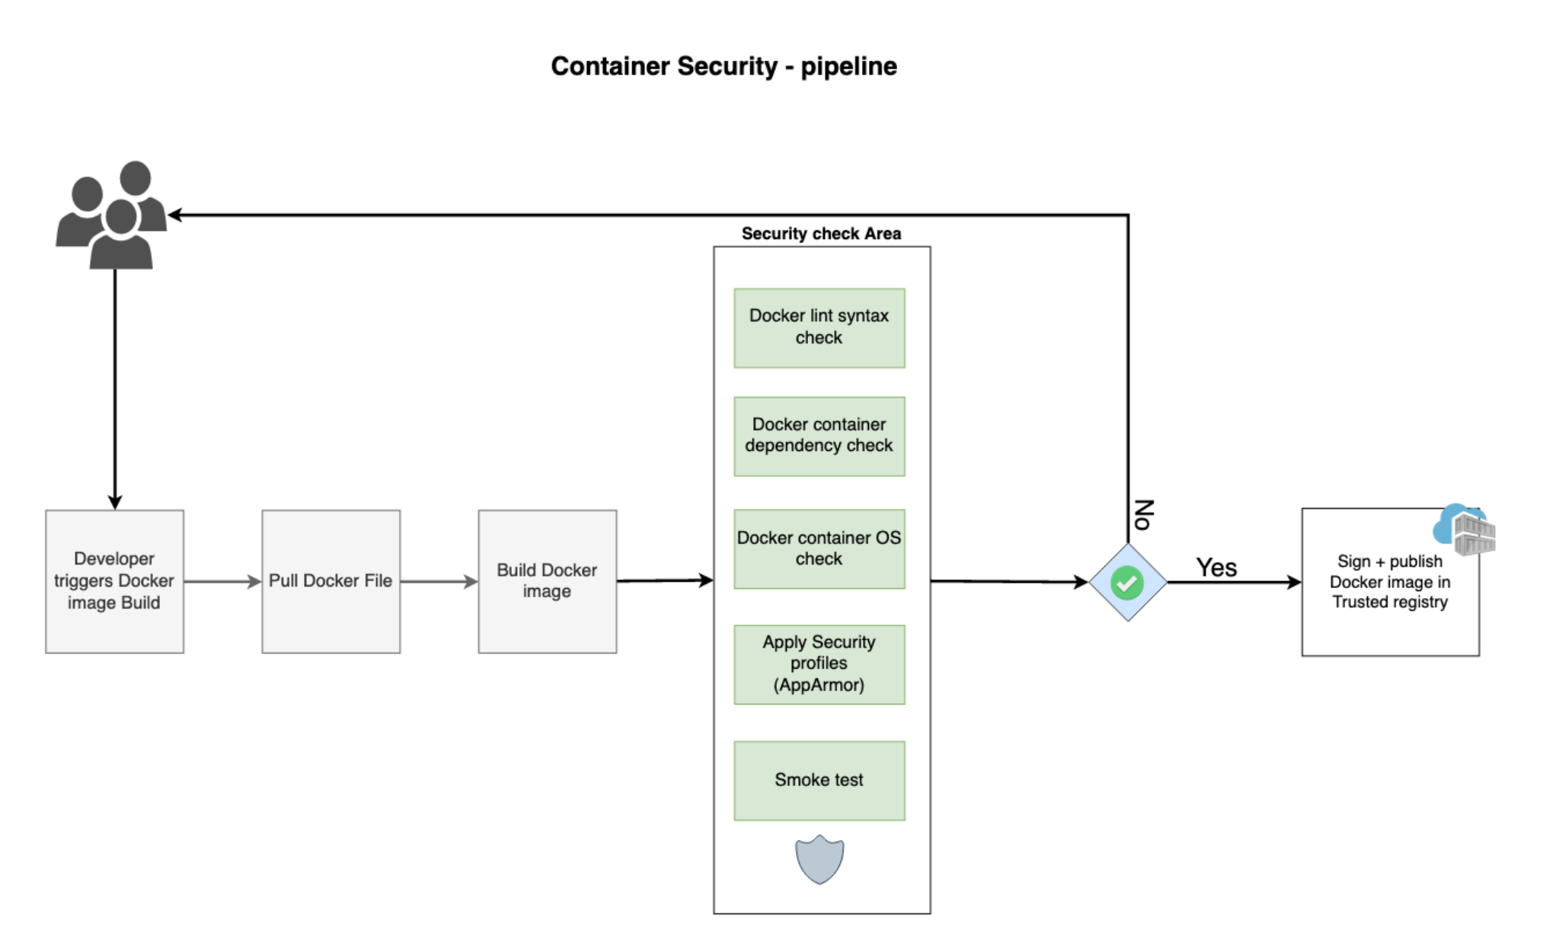
You can use it at the build phase when you’re actually building for instance a Dockerfile and looking at the resulting image that you’re creating. Another location to perform container scanning would be when you push a container to the registry or when you pull a container from a registry. However, a good approach is scanning before pushing into a trusted container registry then you can say we have a container registry with a scanned version of all images and for deploying in production you can pull from this trusted container registry. (Plase take look into the following image)

Slide 45
Tools:
Clair - Vulnerability Static Analysis for Containers
Anchore - Open-source project for deep analysis of docker images
Dagda - A tool to perform static analysis of known vulnerabilities, trojans, viruses, malware & other malicious threats in docker images/containers and to monitor the docker daemon and running docker containers for detecting anomalous activities
Falco - Falco, the cloud-native runtime security project, is the de facto Kubernetes threat detection engine
Harbor - Harbor is an open source registry that secures artifacts with policies and role-based access control, ensures images are scanned and free from vulnerabilities, and signs images as trusted.
Trivy - Trivy is a simple and comprehensive vulnerability/misconfiguration scanner for containers and other artifacts.
References
Opensource.com - tools for container security
https://opensource.com/article/18/8/tools-container-security
Privacy
Privacy has become an important aspect of application security. GDPR, LGPD, CCPA and other laws and regulations have impose several controls over processing PII (Personally Identifiable Information). To comply with those regulations, DevSecOps have to be sure to use PII accordingly and protect data agains leaking.
To start, it is important to have a good understanding of what is considered PII:

Slide 46
First and last name;
Identifiable email (name.lastname@domain.com);
Identity card numbers;
Location data (mobile);
IP Address.
This is not a complete list.
Some PII are considered sensitive, and require even more protection, such as:
Racial or ethnic origin;
Political opinions;
Religious or philosophical beliefs;
Trade union membership;
Genetic data; and
Biometric data (where processed to uniquely identify someone).
Most privacy regulations promote Privacy by Design, the aproach where the development process addresses privacy concerns thru the whole cycle. Even before coding starts.
You have to create a PII data flow to make sure you apply the required protection to the data thru its lifecycle. You also have to follow all the requirements related to the quality and volume of processed data.
All PII data processing requirements have to be specified. you have to create an inventory of all PII and evaluate the processing activity to make sure it follows all requirementes, such as:

Slide 47
Lawfulness, fairness and transparency
Purpose limitation
Data minimization
Accuracy
Storage limitation
Integrity and confidentiality (security)
Accountability
After you make sure that the PII and the PII processing activity are mapped and comply to the privacy regulation you have to follow, it is important to apply the security measures to protect the data, accordingly with its criticity.
https://www.microsoft.com/en-us/securityengineering/sdl/threatmodeling

